Slide 1
Servlet Session I: Cookie API

Slide 2
Road Map
Creating Cookies
Cookie Attributes
Reading Cookies
Example 1: Basic Counter
Example 2: Tracking Multiple Cookies
Case Study: Customized Search Engine

Slide 3
The Potential of Cookies
Idea
  Servlet sends a simple name and value to client.
  Client returns same name and value when it connects to same site (or same domain, depending on cookie settings).
Typical Uses of Cookies
  Identifying a user during an e-commerce session
  Avoiding username and password
  Customizing a site
  Focusing advertising

Slide 4
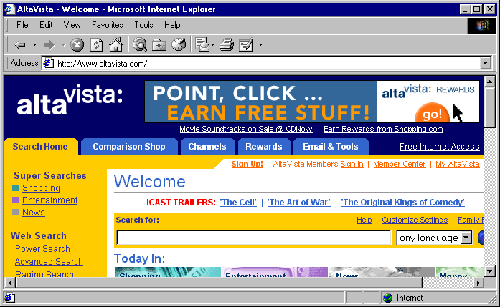
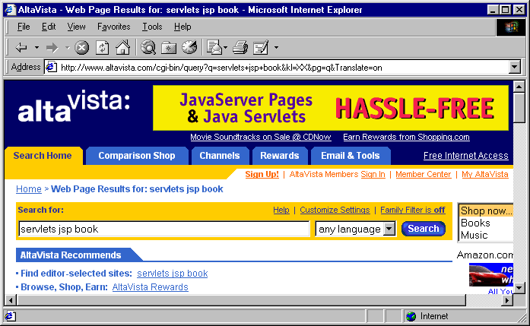
Cookies and Focused Advertising

Slide 5
Creating Cookies

Slide 6
Creating Cookies
Three steps to creating a new cookie:
  Create a new Cookie Object
    Cookie cookie = new Cookie (name, value);
  Set any cookie attributes
    Cookie.setMaxAge (60);
  Add your cookie to the response object:
    Response.addCookie (cookie)
We will examine each of these steps in detail.

Slide 7
Sending Cookies to the Client
Create a Cookie object.
  Call the Cookie constructor with a cookie name and a cookie value, both of which are strings.
    Cookie c = new Cookie("userID", "a1234");
Set the maximum age.
  To tell browser to store cookie on disk instead of just in memory, use setMaxAge (argument is in seconds)
    c.setMaxAge(60*60*24*7); // One week
Place the Cookie into the HTTP response
  Use response.addCookie.
  If you forget this step, no cookie is sent to the browser!
    response.addCookie(c);

Slide 8
1. Cookie Constructor
You create a new cookie by calling the Cookie constructor and specifying:
  Name
  Value
Example:
  Cookie cookie = new Cookie (“school”, “NYU”);
Neither the name nor the value should contain whitespace or any of the following characters:
  [ ] ( ) = , “ / ? @ ;

Slide 9
2. Set Cookie Attributes
Before adding your cookie to the Response object, you can set any of its attributes.
Attributes include:
  Name/Value
  Domain
  Maximum Age
  Path
  Version

Slide 10
Cookie Name
public String getName();
public void setName (String name);
You rarely call setName() directly, as you specify the name in the cookie constructor.
getName() is useful for reading in cookies.

Slide 11
Domain Attributes
public String getDomain ();
public void setDomain(String domain);
Normally, the browser only returns cookies to the exact same host that sent them.
You can use setDomain() to instruct the browser to send cookies to other hosts within the same domain.

Slide 12
Domain Example
Example: Cookies sent from a servlet at bali.vacations.com would not be forwarded to mexico.vacations.com.
If you do want to the cookie to be accessible to both hosts, set the domain to the highest level:
  cookie.setDomain (“.vacations.com”);
Note that you are always required to include at least two dots. Hence, you must specify .vacations.com, not just vacations.com

Slide 13
Cookie Age
public int getMaxAge ();
public void setMaxAge (int lifetime);
In general there are two types of cookies:
  Session Cookies: Temporary cookies that expire when the user exits the browser.
  Persistent Cookies: Cookies that do not expire when the user exits the browser. These cookies stay around until their expiration date, or the user explicitly deletes them.

Slide 14
Cookie Expiration
The setMaxAge () method tells the browser how long (in seconds) until the cookie expires.
Possible values:
  Negative Value (-1) (default): creates a session cookie that is deleted when the user exits the browser.
  0: instructs the browser to delete the cookie.
  Positive value: any number of seconds. For example, to create a cookie that lasts for one hour, setMaxAge (3600);

Slide 15
Path
public String getPath();
public void setPath (String path);
By default, the browser will only return a cookie to URLs in or below the directory that created the cookie.

Slide 16
Path Example
Example: If you create a cookie at http://ecommerce.site.com/toys.html then:
  The browser will send the cookie back to http://ecommerce.site.com/toys.html.
  The browser will not send the cookie back to http://ecommerce.site.com/cds
If you want the cookie to be sent to all pages, set the path to /
  Cookie.setPath (“/”);
  Very common, widely used practice.

Slide 17
Security
public int getSecure ();
public void setSecure (boolean);
If you set Secure to true, the browser will only return the cookie when connecting over an encrypted connection.
By default, cookies are set to non-secure.

Slide 18
Comments
public int getComment ();
public void Comment (String)
Comments: you can specify a cookie comment via the setComment() method. But, comments are only supported in Version 1 cookies.
Hence, no one really uses these methods…

Slide 19
3. Add Cookies to Response
Once you have created your cookie, and set any attributes, you add it to the response object.
By adding it to the response object, your cookie is transmitted back to the browser.
Example:
  Cookie school = new Cookie (“school”, “NYU”);
  school.setMaxAge (3600);
  response.addCookie (school);

Slide 20
Sending Cookies to the Client
Create a Cookie object.
  Call the Cookie constructor with a cookie name and a cookie value, both of which are strings.
    Cookie c = new Cookie("userID", "a1234");
Set the maximum age.
  To tell browser to store cookie on disk instead of just in memory, use setMaxAge (argument is in seconds)
    c.setMaxAge(60*60*24*7); // One week
Place the Cookie into the HTTP response
  Use response.addCookie.
  If you forget this step, no cookie is sent to the browser!
    response.addCookie(c);

Slide 21
Reading Cookies

Slide 22
Reading Cookies
To create cookies, add them to the response object.
To read incoming cookies, get them from the request object.
HttpServletRequest has a getCookies() method.
  Returns an array of cookie objects. This includes all cookies sent by the browser.
  Returns a zero-length array if there are no cookies.

Slide 23
getValue/setValue
getValue/setValue
  Gets/sets value associated with cookie.
  For new cookies, you supply value to constructor, not to setValue.
  For incoming cookie array, you use getName to find the cookie of interest, then call getValue on the result.
  If you set the value of an incoming cookie, you still have to send it back out with response.addCookie.

Slide 24
Reading Cookies
Once you have an array of cookies, you can iterate through the array and extract the one(s) you want.
Our next few examples illustrate how this is done.

Slide 25
Example 1: RepeatVisitor.java
This servlet checks for a unique cookie, named “repeatVisitor”.
  If the cookie is present, servlet says “Welcome Back”
  Otherwise, servlet says “Welcome aboard”.
Example: Listing 8.1

Slide 26
Using Cookies to Detect
First-Time Visitors
public class RepeatVisitor extends HttpServlet {
public void doGet(HttpServletRequest request,
HttpServletResponse response)
throws ServletException, IOException {
boolean newbie = true;
Cookie[] cookies = request.getCookies();
if (cookies != null) {
for(int i=0; i<cookies.length; i++) {
Cookie c = cookies[i];
if((c.getName().equals("repeatVisitor"))&&
(c.getValue().equals("yes"))) {
newbie = false;
break;
}
}
}

Slide 27
Using Cookies to Detect
First-Time Visitors (Continued)
String title;
if (newbie) {
Cookie returnVisitorCookie =
new Cookie("repeatVisitor", "yes");
returnVisitorCookie.setMaxAge(60*60*24*365);
response.addCookie(returnVisitorCookie);
title = "Welcome Aboard";
} else {
title = "Welcome Back";
}
response.setContentType("text/html");
PrintWriter out = response.getWriter();
… // (Output page with above title)

Slide 28
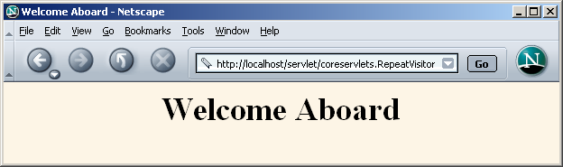
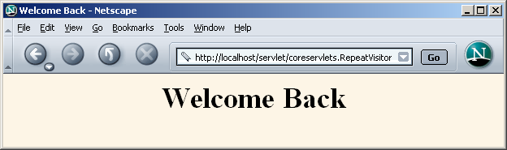
Using Cookies to Detect
First-Time Visitors (Results)
(run example)

Slide 29
Example 2: CookieTest.java
Illustrates the differences between session and persistent cookies.
Creates a total of six cookies:
  Three are session cookies
  Three are persistent cookies
Servlet also uses request.getCookies() to find all incoming cookies and display them.
Listing 8.2:

Slide 30
Differentiating Session Cookies from Persistent Cookies
public class CookieTest extends HttpServlet {
public void doGet(HttpServletRequest request,
HttpServletResponse response)
throws ServletException, IOException {
for(int i=0; i<3; i++) {
Cookie cookie =
new Cookie("Session-Cookie-" + i,
"Cookie-Value-S" + i);
// No maxAge (ie maxAge = -1)
response.addCookie(cookie);
cookie = new Cookie("Persistent-Cookie-" + i,
"Cookie-Value-P" + i);
cookie.setMaxAge(3600);
response.addCookie(cookie);
}

Slide 31
Differentiating Session Cookies from Persistent Cookies (Cont)
… // Start an HTML table
Cookie[] cookies = request.getCookies();
if (cookies == null) {
out.println("<TR><TH COLSPAN=2>No cookies");
} else {
Cookie cookie;
for(int i=0; i<cookies.length; i++) {
cookie = cookies[i];
out.println
("<TR>\n" +
" <TD>" + cookie.getName() + "\n" +
" <TD>" + cookie.getValue());
}
}

Slide 32
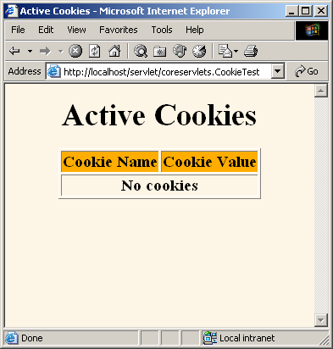
Differentiating Session Cookies from Persistent Cookies
Result of initial visit to CookieTest servlet
  Same result as when visiting the servlet, quitting the browser, waiting an hour, and revisiting the servlet.

Slide 33
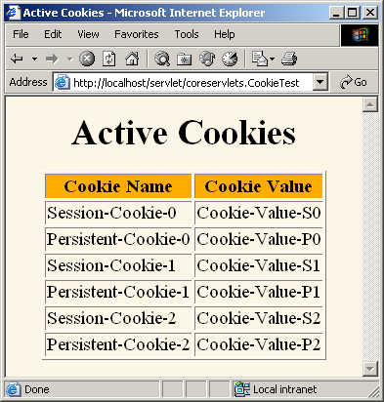
Differentiating Session Cookies from Persistent Cookies (run)
Result of revisiting CookieTest within an hour of original visit (same browser session)
  I.e., browser stayed open between the original visit and the visit shown here

Slide 34
Example 3: CookieUtilities
Utility class (from coreservlets package):
- that simplifies the retrieval of a cookie value, given a cookie name.
- if value is not set, it will be set to defaultvalue that you supply to the method.
You can use in all your programs that deals with cookie retrieval
It saves time because you do not have to repeat same steps and details every time you deal with cookie (hide details):
    Retrieve all cookies array
    go through loop to find name,value.
CookiesUtilities two Main static methods (details 8.3 in book)
  getCookieValue (HttpServletRequest request, String cookieName, String defaultValue)
    // given request object and cookie name and defaultvalue, getCookieValue method return
    // a cookievalue with matching name, in no value found return
    //“defaultvalue” supplied
  getCookie (HttpServletRequest request, String cookieName)
    // given request object and cookie name, getCookie method return a cookie with //matching name, in no name found return “null”… see details for this method (8.3 in book)

Slide 35
CookieUtilities: Finding Cookies with Specified Names
public class CookieUtilities {
  // has two methods (details 8.3 in book)
  //Given the request, a name, a default value, this
  // method tries to find the value of the cookie with
  // the given name.
  // if no cookie matches the name, the designated
  // default value is returned
public static String getCookieValue
(HttpServletRequest request,
String cookieName,
String defaultValue) {
Cookie[] cookies = request.getCookies();
if (cookies != null) {
for(int i=0; i<cookies.length; i++){// loop through available cookie
Cookie cookie = cookies[i];
if (cookieName.equals(cookie.getName())) {
return(cookie.getValue());// return value for match name
}
}
} // if no cookie match, return default value
return(defaultValue); }}

Slide 36
Another helpful Utility (coreservlets package):
LongLivedCookie (8.4 in book)
  // small class you can use instead of Cookie if you want to your
  //cookie to automatically bet set (persists) for one year rather
  //than be deleted when browser closes(session cookie by default)
public class LongLivedCookie extends Cookie {
public static final int SECONDS_PER_YEAR = 60*60*24*365;
public LongLivedCookie(String name, String value) {
super(name, value);
setMaxAge(SECONDS_PER_YEAR);
}
}

Slide 37
Applying Utilities:
RepeatVisitor2 example (8.4 in BOOK) produces same result as last example (8.2) but using utilities provided by coreservlets package to make it easier (run)
public class RepeatVisitor2 extends HttpServlet {
public void doGet(HttpServletRequest request,
HttpServletResponse response)
throws ServletException, IOException {
boolean newbie = true;
// CookieUtilities.getCookieValue loops through available cookie and return
// value for cookie name “repeatVisitor2” which is “yes”
// if no match rturn default “no”
String value =
CookieUtilities.getCookieValue(request,
"repeatVisitor2", "no");
if (value.equals("yes")) {
newbie = false;
}
String title;
if (newbie) {
//if new_cookie, create a new one and set to one year using LongLivedCookie
LongLivedCookie returnVisitorCookie =
new LongLivedCookie("repeatVisitor2", "yes");
response.addCookie(returnVisitorCookie);
title = "Welcome Aboard";
} else {
title = "Welcome Back"; }

Slide 38
Modifying Cookie Values
Replacing a cookie value
  Send the same cookie name with a different cookie value.
  Reusing incoming Cookie objects.
    Need to call response.addCookie; merely calling setValue is not sufficient.
    Also need to reapply any relevant cookie attributes by calling setMaxAge, setPath, etc.—cookie attributes are not specified for incoming cookies.
    Usually not worth the bother, so new Cookie object used
To delete cookie:
  Instructing the browser to delete a cookie
    Use setMaxAge to assign a maximum age of 0.

Slide 39
Example : ClientAccessCount (8.6 in book)
- display the number of hits for each user.
- The value of the cookie will be the counter
- change the value of cookie with each visit (increment )
A few weeks back, we created a simple Counter servlet that keeps track of the number of “hits”.
Now, we want to display the number of hits for each user.
This is relatively simple to do:
  We just create a counter cookie
  The value of the cookie will be the counter
  Increment the counter with each visit
  and increment the counter cookie at each visit.
Listing 8.6:

Slide 40
Tracking User Access Counts
public class ClientAccessCounts extends HttpServlet {
public void doGet(HttpServletRequest request,
HttpServletResponse response)
throws ServletException, IOException {
// utility return cookie value(representing counter) as a string
// “10”) for cookie name “accessCount”).
//If no value, return default “1”
String countString = CookieUtilities.getCookieValue(request, "accessCount", "1");
int count = 1;
try {
// convert string value “1” to integer
count = Integer.parseInt(countString); // convert count to integer
} catch(NumberFormatException nfe) { }
LongLivedCookie c = new LongLivedCookie("accessCount",
String.valueOf(count+1)); // increment counter by 1
// add cookie info to to response (with new updated counter as value of cookie)
response.addCookie(c);

Slide 41
Tracking User Access Counts (Continued)
// print result or number of visits per browser
out.println(docType +
"<HTML>\n" +
"<HEAD><TITLE>" + title +
"</TITLE></HEAD>\n" +
"<BODY BGCOLOR=\"#FDF5E6\">\n" +
"<CENTER>\n" +
"<H1>" + title + "</H1>\n" +
"<H2>This is visit number " +
count + " by this browser.</H2>\n"+
"</CENTER></BODY></HTML>");
}
}

Slide 42
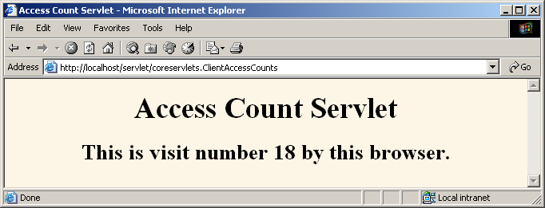
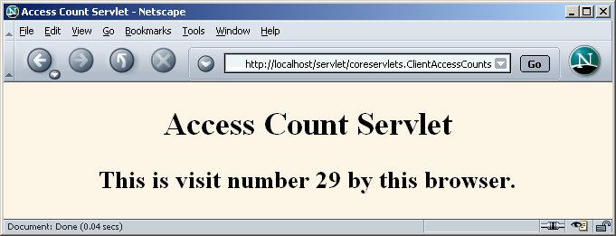
Tracking User Access Counts (Results) (run live)

Slide 43
Summary
To create a cookie:
  Create a new Cookie Object
    Cookie cookie = new Cookie (name, value);
  Set any cookie attributes
    Cookie.setMaxAge (60);
  Add your cookie to the response object:
    Response.addCookie (cookie)
You can use utilities provided with coreservlets to make process easier
  CookieUtilities.getCookieValue
  LongLivedCookie

Slide 44
Midterm Exam
Midterm Wed MAR 2 (during class)
Required readings
  All PowerPoint lectures posted on the website
  Core Servlets:
    Chapter 1, Chapter 2 (skip sections 2.5-2.6, 2.11)
    Chapter3
    Chapter 4 (skip sections 4.7 - 4.8),
    Chapter 5 (skip sections 5.4 and 5.6)
    Chapter 6,
    Chapter 7 (Skip Sections 7.4 - 7.5)
    Chapter 8
    Chapter 19
Questions: will be based on Core Servlets readings, lectures, examples and Homework

Slide 45
Midterm Exam (format)
Questions: will be based or readings, lectures, examples and Homework
  20-30 Multiple choice (testing main concepts)
  1 write complete servlet (30 pts) (similar to example and to homework:
    Generate and parse forms
    Read and write to file
    Get data from form, headers and cookies
    Keep persistent counts
    Use data structure
    and other manipulations similar to homework
  Your servlets will be graded based on syntax and does the code actually work, and comments and modularity
  Paragraph questions 3- 8 (find errors and why, etc..)

